Slide 1
Inference about population proportions
Sections 7.3, 8.3-8.4, 9.4, 10.3
Chap 7-<number>

Slide 2
Population Proportions (7.3)
π = the proportion of the population having
some characteristic
Sample proportion (p) is an estimate of π:
0 ≤ p ≤ 1
p has an approximately normal distribution when n is large
The distribution of X is … … ?
Chap 7-<number>

Slide 3
Population Proportions
π = the proportion of the population having
some characteristic
Sample proportion (p) is an estimate of π:
0 ≤ p ≤ 1
p has an approximately normal distribution when n is large
X is Binomial (n, π)
Chap 7-<number>

Slide 4
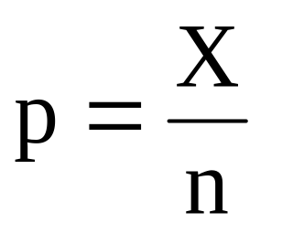
Population Proportions
X is Binomial (n, π)
E(X) = n π, Var (X) = n π(1- π)
E(p) = E(X/n) = E(X)/n = π (it is unbiased)
Var(p) = Var(X/n) = Var(X)/n² = π(1- π)/n
Chap 7-<number>

Slide 5
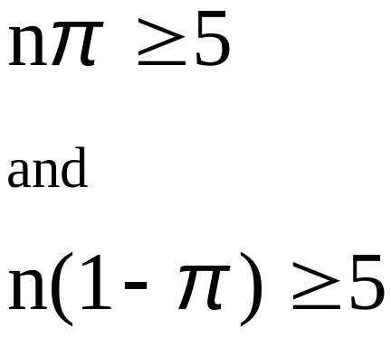
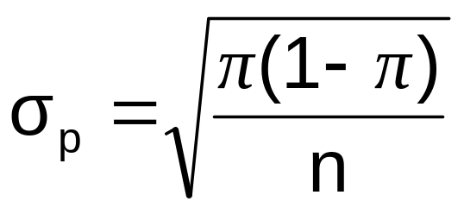
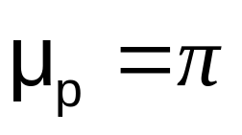
Sampling Distribution of p
Approximated by a
normal distribution if:
  where
Sampling Distribution
P( p_{s})
.3
.2
.1
0
0 . 2 .4 .6 8 1
p
(where π = population proportion and p = sample proportion)
Chap 7-<number>

Slide 6
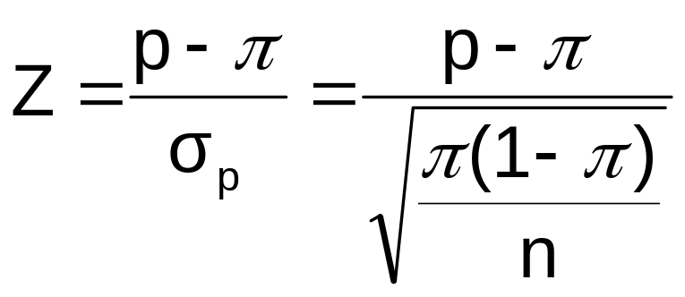
Z-Value for Proportions
Standardize p to a Z value with the formula:
Chap 7-<number>

Slide 7
Example
If the true proportion of voters who support Proposition A is π = 0.4, what is the probability that a sample of size 200 yields a sample proportion between 0.40 and 0.45?
i.e.: if π = 0.4 and n = 200, what is
P(0.40 ≤ p ≤ 0.45) ?
Chap 7-<number>

Slide 8
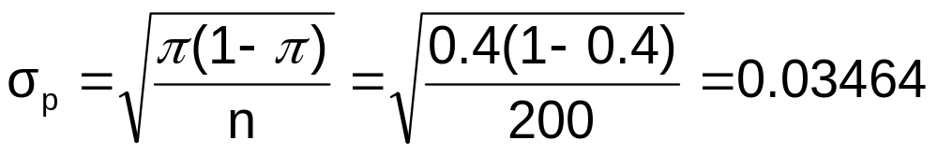

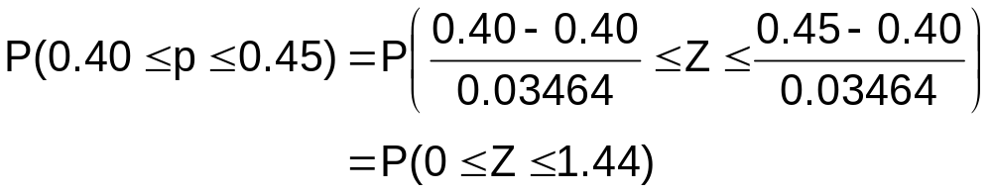
Example
(continued)
if π = 0.4 and n = 200, what is
P(0.40 ≤ p ≤ 0.45) ?
Find :
Convert to standardized normal:
Chap 7-<number>

Slide 9
Example
(continued)
if π = 0.4 and n = 200, what is
P(0.40 ≤ p ≤ 0.45) ?
Utilize the cumulative normal table:
P(0 ≤ Z ≤ 1.44) = 0.9251 – 0.5000 = 0.4251
Standardized
Normal Distribution
Sampling Distribution
0.4251
Standardize
0.40
0.45
p
0
1.44
Z
Chap 7-<number>

Slide 10
Example
Textbook, # 7.12
Chap 7-<number>

Slide 11
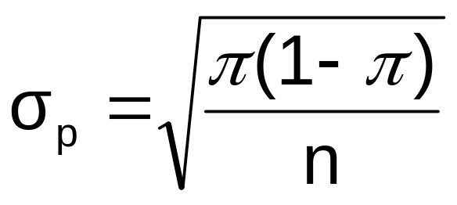
Confidence Intervals for the
Population Proportion (8.3)
General formula –
Estimate = p
Standard error
… but it is unknown!
Point Estimate ± (Critical Value)(Standard Error)
Chap 8-<number>

Slide 12
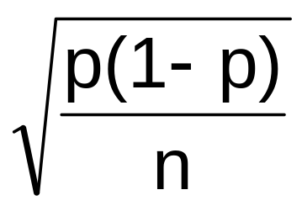
Confidence Intervals for the
Population Proportion, π
(continued)
The true standard deviation is
We will estimate this from the sampled data by
Chap 8-<number>

Slide 13
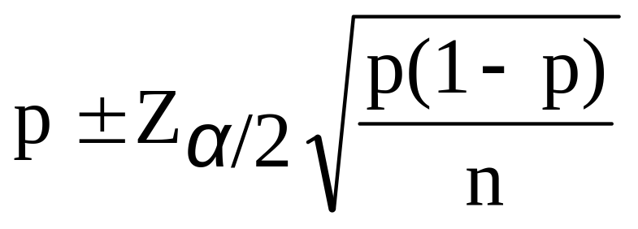
Confidence Interval Endpoints
The confidence interval for the population proportion is calculated by the formula
where
  Z_{α/2} is the standard normal value for the level of confidence desired
  p is the sample proportion
  n is the sample size
Note: must have np ≥ 5 and n(1-p) ≥ 5
Chap 8-<number>

Slide 14

Example
A random sample of 100 people shows that 25 are left-handed.
Form a 95% confidence interval for the true proportion of left-handers
Chap 8-<number>

Slide 15
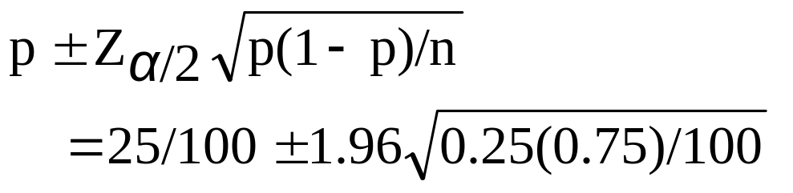
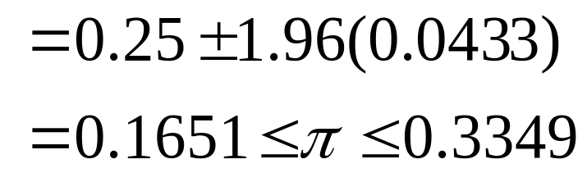
Example
(continued)
A random sample of 100 people shows that 25 are left-handed. Form a 95% confidence interval for the true proportion of left-handers.
Chap 8-<number>

Slide 16
Interpretation
We are 95% confident that the true percentage of left-handers in the population is between
16.51% and 33.49%.
Although the interval from 0.1651 to 0.3349 may or may not contain the true proportion, 95% of intervals formed from samples of size 100 in this manner will contain the true proportion.
Chap 8-<number>

Slide 17
Example
Textbook, #8.28
Chap 8-<number>

Slide 18
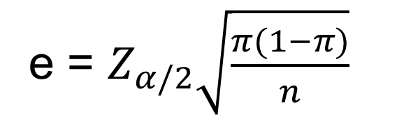
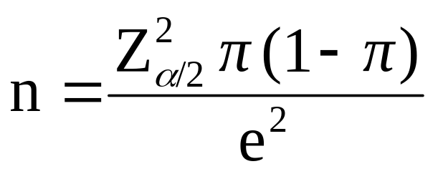
Determining Sample Size (8.4)
(continued)
Determining
Sample Size
For the
Proportion
Now solve for n to get
Chap 8-<number>

Slide 19
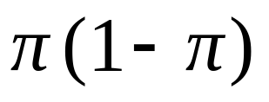
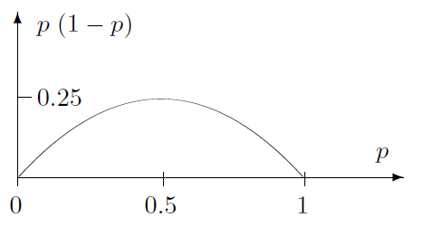
Determining Sample Size
(continued)
To determine the required sample size for the proportion, we must know the true proportion of events of interest, π
    π can be estimated with a pilot sample
    or conservatively use 0.5 as an estimate of π
    Notice that is maximized by π=0.5.
Chap 8-<number>

Slide 20
Required Sample Size Example
How large a sample would be necessary to estimate the true proportion defective in a large population within ±3%, with 95% confidence?
(Assume a pilot sample yields p = 0.12)
Chap 8-<number>

Slide 21
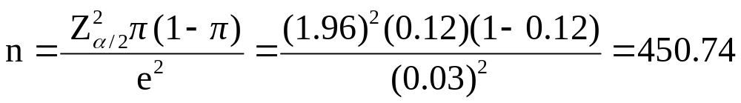
Required Sample Size Example
(continued)
Solution:
For 95% confidence, use Z_{α/2} = 1.96
e = 0.03
p = 0.12, so use this to estimate π
So use n = 451
Chap 8-<number>

Slide 22
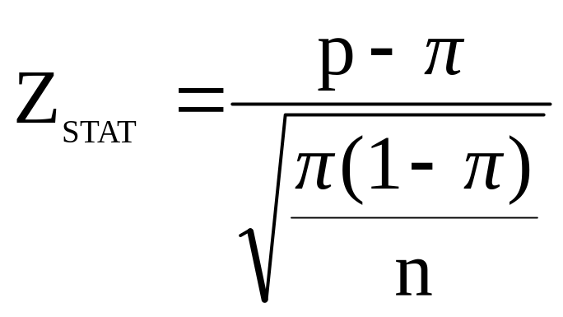
Hypothesis Tests for Proportions (9.4)
The sampling distribution of p is approximately normal, so the test statistic is a Z_{STAT} value:
Hypothesis
Tests for p
nπ ≥ 5
and
n(1-π) ≥ 5
nπ < 5
or
n(1-π) < 5
Not discussed in this chapter
.
Chap 9-<number>

Slide 23

Example: Z Test for Proportion
A marketing company claims that it receives 8% responses from its mailing. To test this claim, a random sample of 500 were surveyed with 25 responses. Test at the α = 0.05 significance level.
Check:
n π = (500)(.08) = 40
n(1-π) = (500)(.92) = 460
✓
.
Chap 9-<number>

Slide 24
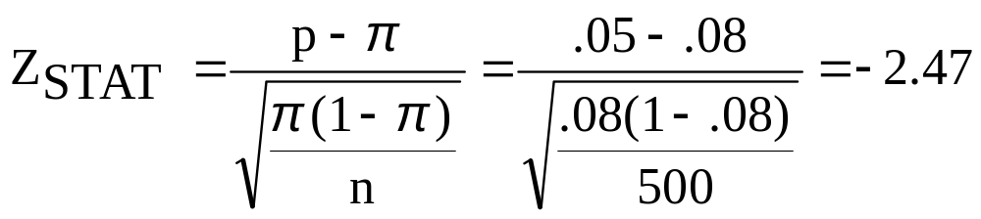
Z Test for Proportion: Solution
Test Statistic:
H₀: π = 0.08 H₁: π ≠ 0.08
α = 0.05
n = 500, p = 0.05
Critical Values: ± 1.96
Decision:
Reject H₀ at α = 0.05
Reject
Reject
Conclusion:
.025
.025
There is sufficient evidence to reject the company’s claim of 8% response rate.
z
-1.96
0
1.96
-2.47
.
Chap 9-<number>

Slide 25
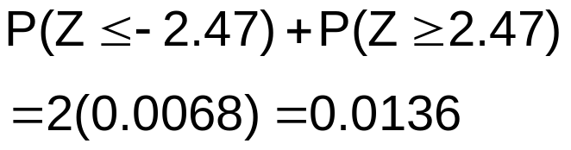
p-Value Solution
(continued)
Calculate the p-value and compare to α
(For a two-tail test the p-value is always two-tail)
Do not reject H₀
Reject H₀
Reject H₀
p-value = 0.0136:
α/2 = .025
α/2 = .025
0.0068
0.0068
-1.96
0
1.96
Z = -2.47
Z = 2.47
Reject H₀ since p-value = 0.0136 < α = 0.05
.
Chap 9-<number>

Slide 26
Examples
Textbook, # 9.55, 9.58
.
Chap 9-<number>

Slide 27
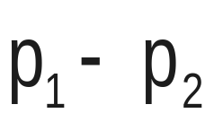
Two Population Proportions (10.3)
Goal: test a hypothesis or form a confidence interval for the difference between two population proportions, π₁ – π₂
Population proportions
Assumptions:
n₁ π₁ ≥ 5 , n₁(1- π₁) ≥ 5
n₂ π₂ ≥ 5 , n₂(1- π₂) ≥ 5
The point estimate for the difference is
Chap 10-<number>

Slide 28
Examples
Textbook, # 10.18, 10.20
Chap 10-<number>

Slide 29
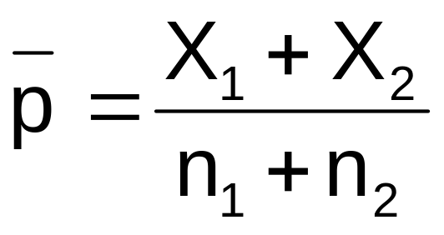
Two Population Proportions
In the null hypothesis we assume the null hypothesis is true, so we assume π₁ = π₂ and pool the two sample estimates
Population proportions
The pooled estimate for the overall proportion is:
where X₁ and X₂ are the number of items of interest in samples 1 and 2
Chap 10-<number>

Slide 30
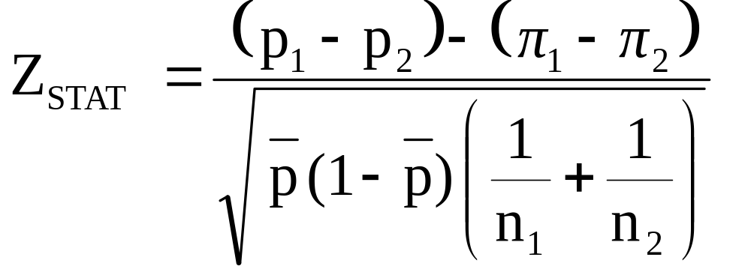
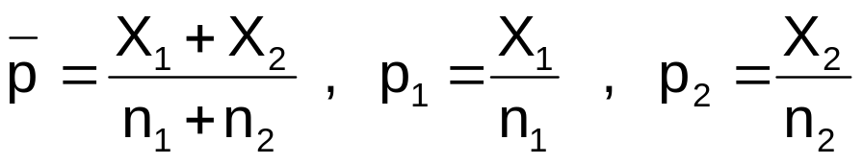
Two Population Proportions
(continued)
The test statistic for
π₁ – π₂ is a Z statistic:
Population proportions
where
Chap 10-<number>

Slide 31
Hypothesis Tests for
Two Population Proportions
Population proportions
Lower-tail test:
H₀: π₁ ≥ π₂
H₁: π₁ < π₂
i.e.,
H₀: π₁ – π₂ ≥ 0
H₁: π₁ – π₂ < 0
Upper-tail test:
H₀: π₁ ≤ π₂
H₁: π₁ > π₂
i.e.,
H₀: π₁ – π₂ ≤ 0
H₁: π₁ – π₂ > 0
Two-tail test:
H₀: π₁ = π₂
H₁: π₁ ≠ π₂
i.e.,
H₀: π₁ – π₂ = 0
H₁: π₁ – π₂ ≠ 0
Chap 10-<number>

Slide 32
Hypothesis Tests for
Two Population Proportions
(continued)
Population proportions
Lower-tail test:
H₀: π₁ – π₂ ≥ 0
H₁: π₁ – π₂ < 0
Upper-tail test:
H₀: π₁ – π₂ ≤ 0
H₁: π₁ – π₂ > 0
Two-tail test:
H₀: π₁ – π₂ = 0
H₁: π₁ – π₂ ≠ 0
α
α
α/2
α/2
-z_{α}
z_{α}
-z_{α/2}
z_{α/2}
Reject H₀ if Z_{STAT} < -Z_{α}
Reject H₀ if Z_{STAT} > Z_{α}
Reject H₀ if Z_{STAT} < -Z_{α/2}
or Z_{STAT} > Z_{α/2}
Chap 10-<number>

Slide 33

Hypothesis Test Example:
Two population proportions
Is there a significant difference between the proportion of men and the proportion of women who will vote Yes on Proposition A?
In a random sample, 36 of 72 men and 35 of 50 women indicated they would vote Yes
Test at the .05 level of significance
Chap 10-<number>

Slide 34
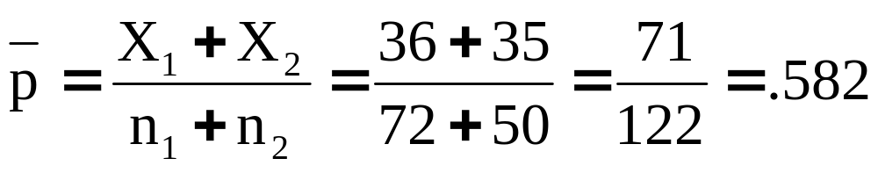
Hypothesis Test Example:
Two population Proportions
(continued)
The hypothesis test is:
H₀: π₁ – π₂ = 0 (the two proportions are equal)
H₁: π₁ – π₂ ≠ 0 (there is a significant difference between proportions)
The sample proportions are:
  Men: p₁ = 36/72 = 0.50
  Women: p₂ = 35/50 = 0.70
The pooled estimate for the overall proportion is:
Chap 10-<number>

Slide 35
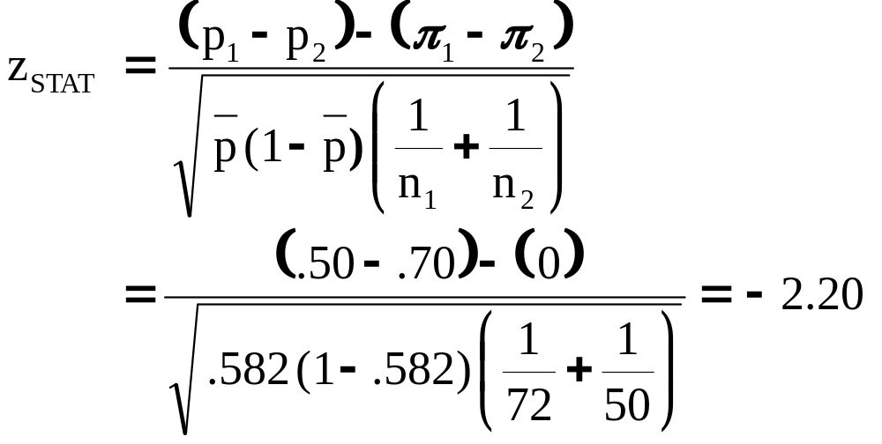
Hypothesis Test Example:
Two population Proportions
(continued)
Reject H₀
Reject H₀
The test statistic for π₁ – π₂ is:
.025
.025
-1.96
1.96
-2.20
Decision: Reject H₀
Conclusion: There is significant evidence of a difference in proportions who will vote yes between men and women.
Critical Values = ±1.96
For α = .05
Chap 10-<number>

Slide 36
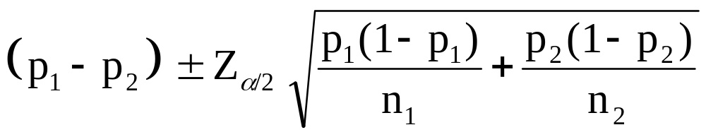
Confidence Interval for
Two Population Proportions
Population proportions
The confidence interval for
π₁ – π₂ is:
Chap 10-<number>

Slide 37
Summary
This week, we discussed
The sampling distribution of a proportion
Confidence interval for a population proportion
Required sample size
Testing proportions
Testing a difference between two proportions
Chap 7-<number>

